Slide 1
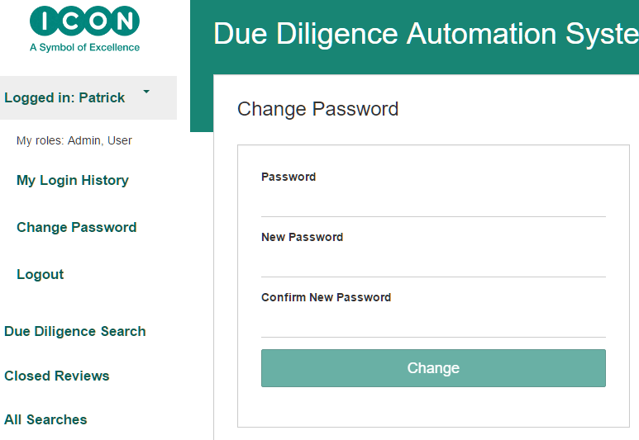

Slide 2
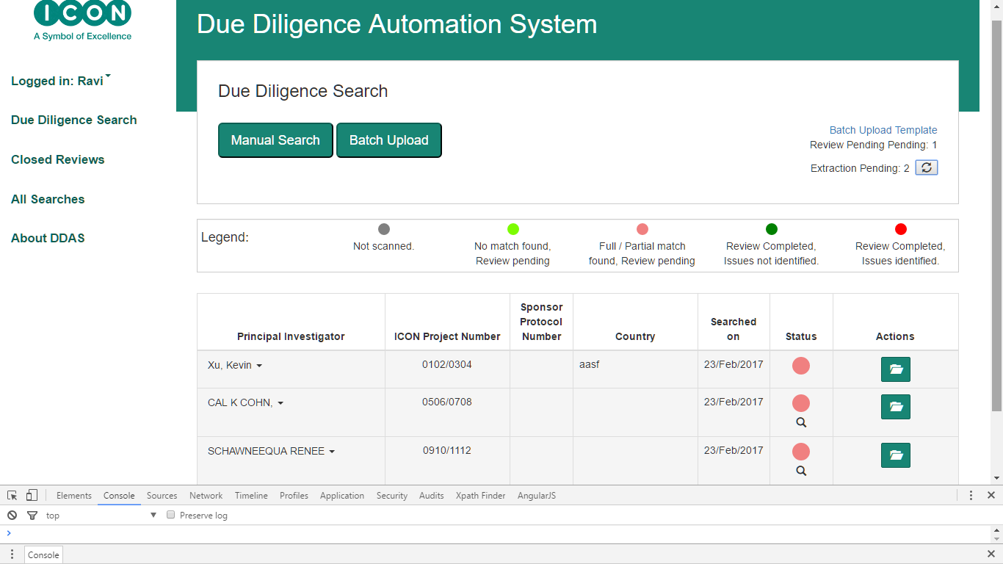
2
3
5
6
1
7
4
8
9
10

Slide 3
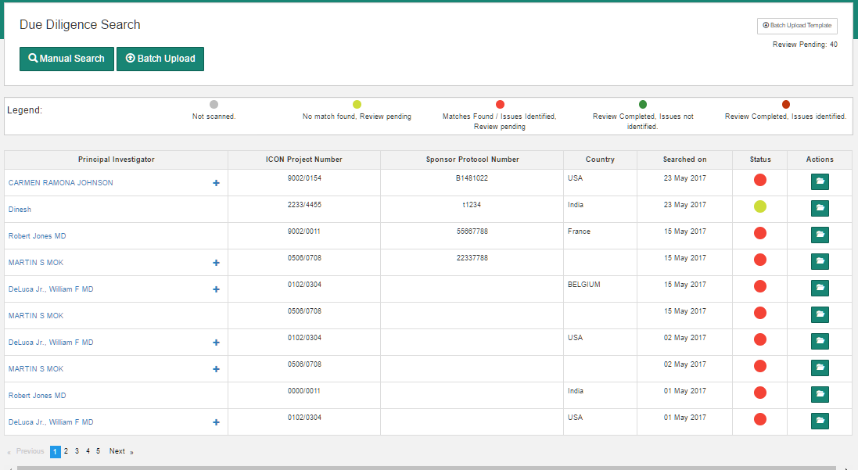
1
2
3
4
5
6

Slide 4
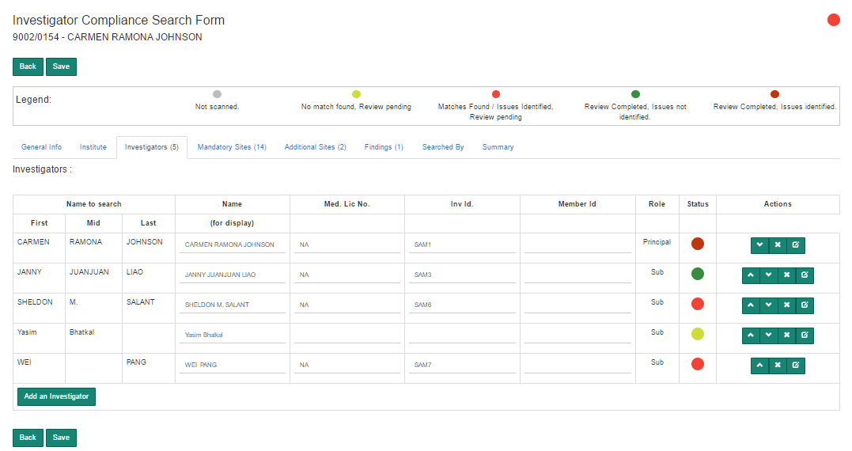

Slide 5
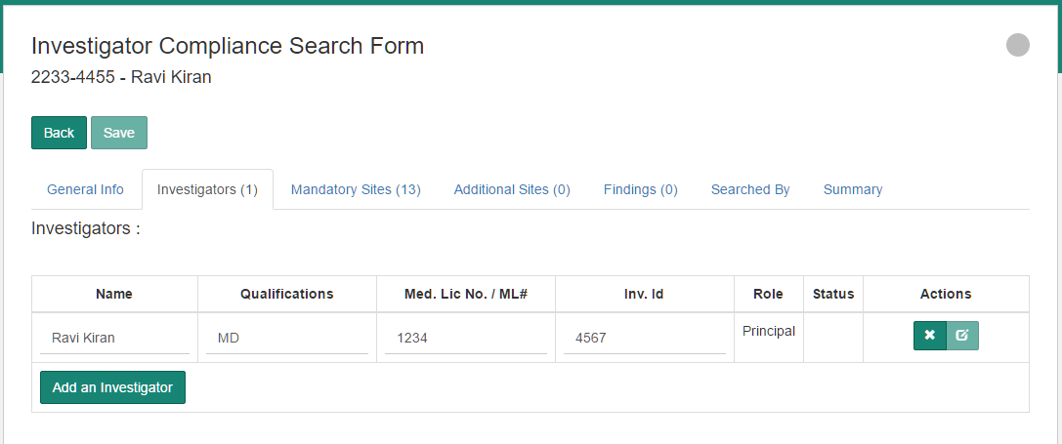

Slide 6
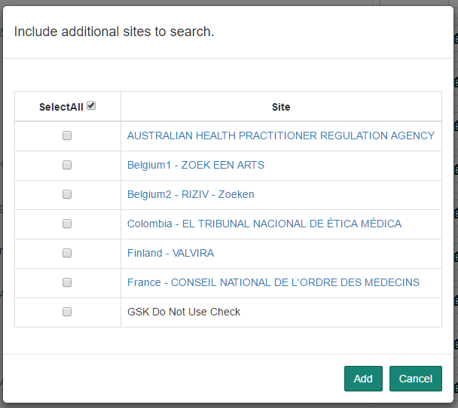
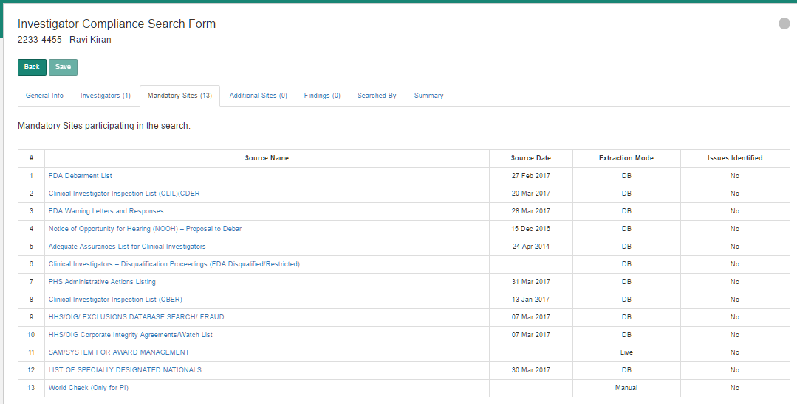

Slide 7
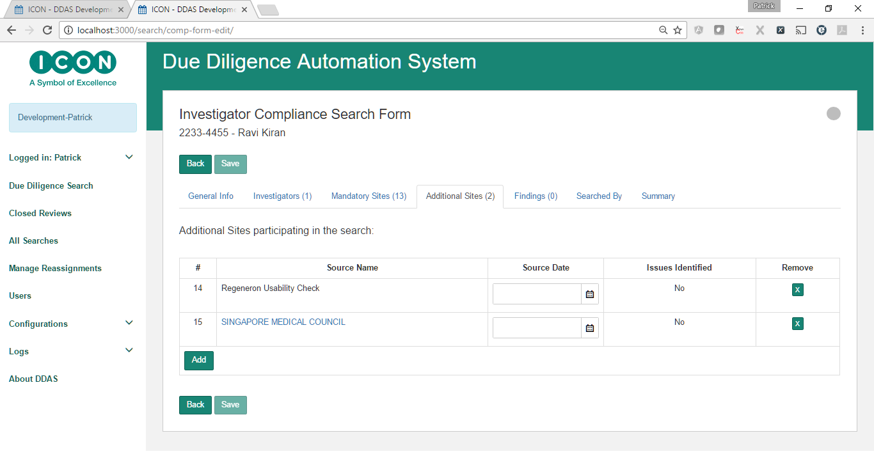

Slide 8
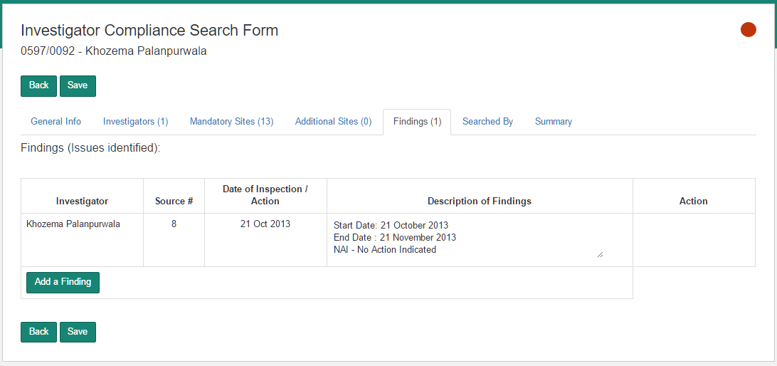

Slide 9
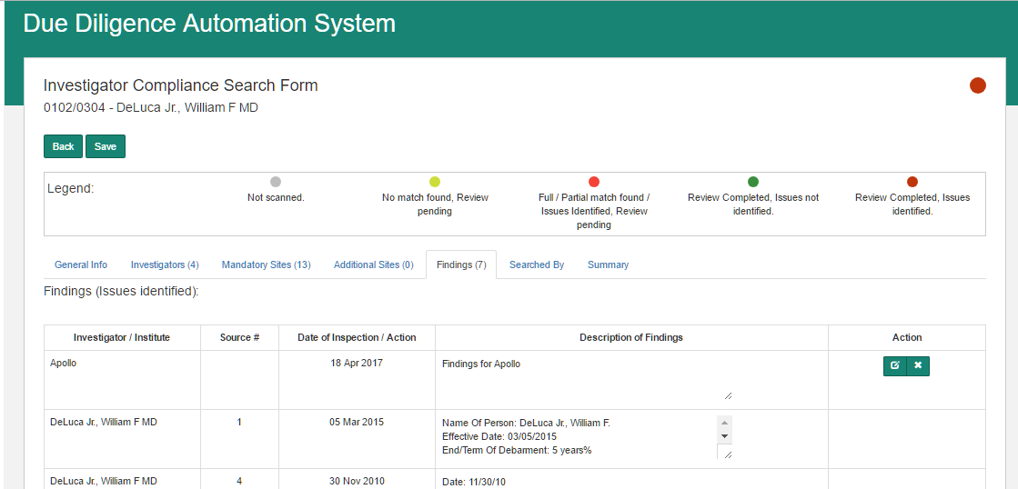
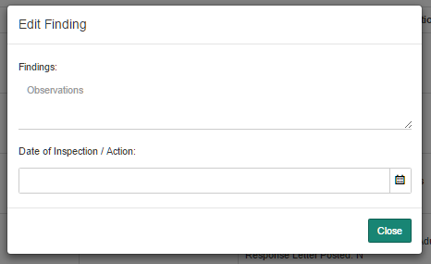
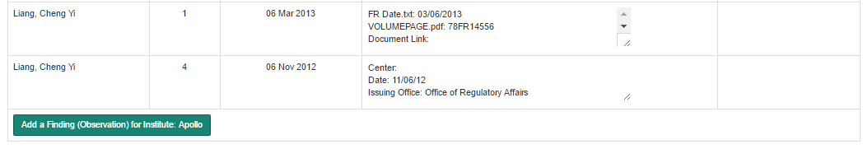

Slide 10
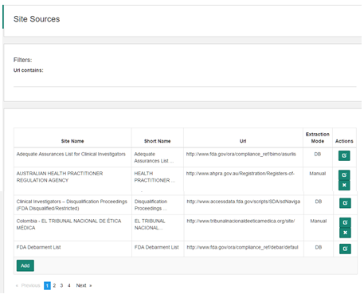
1
2
3
4

Slide 11
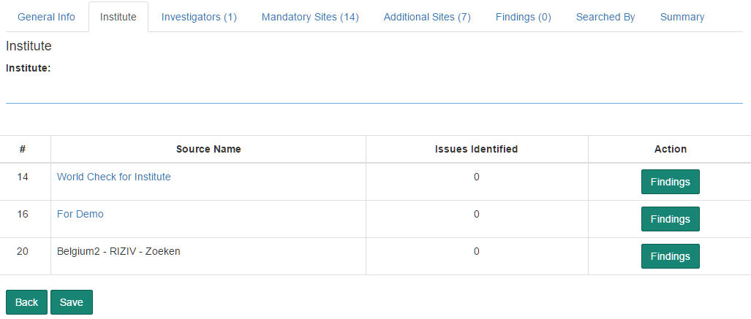

Slide 12
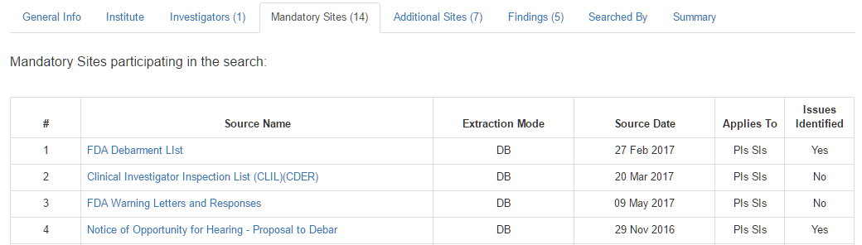
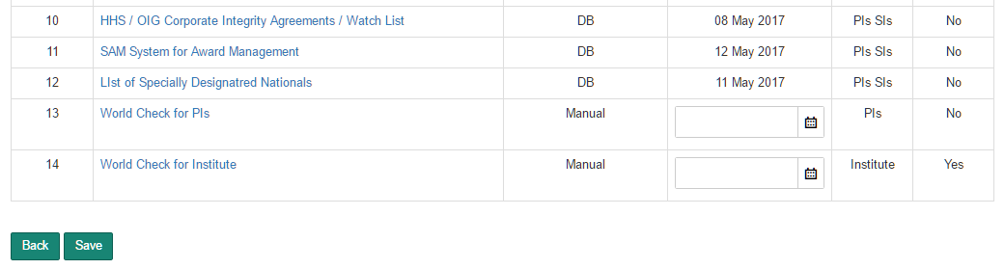

Slide 13
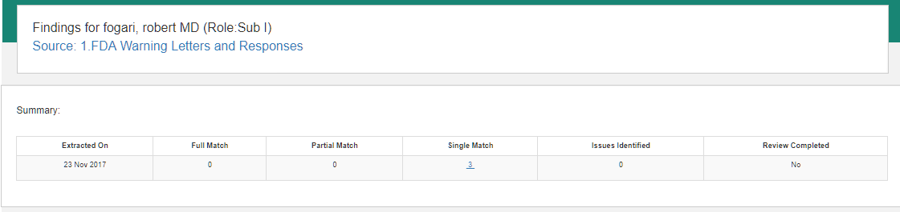
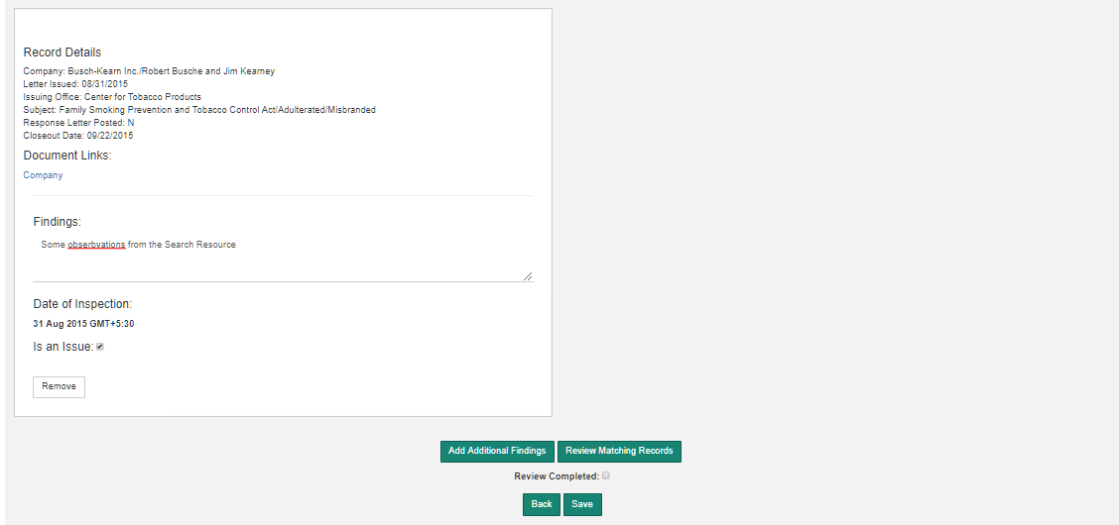

Slide 17
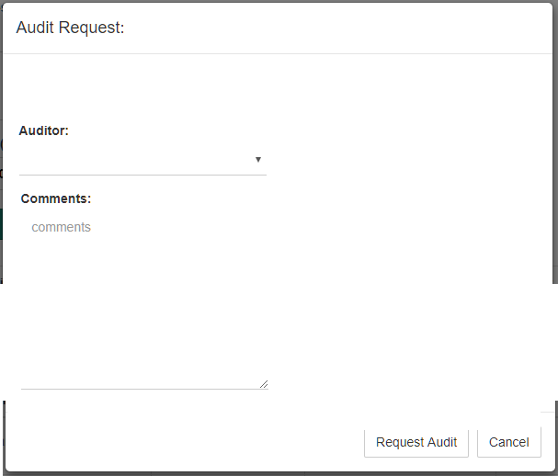
QC Request
Previous QCs
QC Verifier | Requested on | Status
Ramesh | 10-Nov-2017 | Completed
QC Verifier::
Request QC

Slide 18
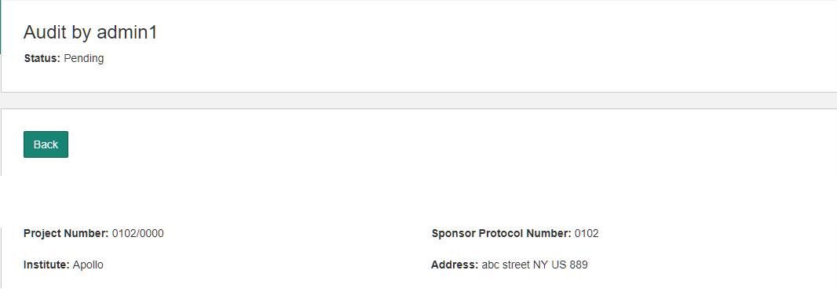
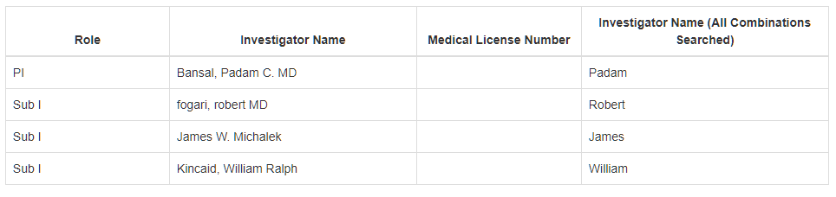
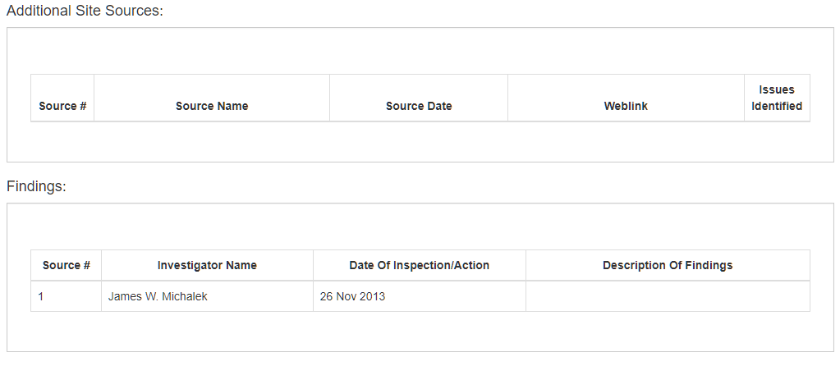
Requested by:
Ramesh Reddy
Requested on: 20-Dec-2017
Requestor’s Comments:
Please review my compliance form. Some points to note …
Investigators:

Slide 19
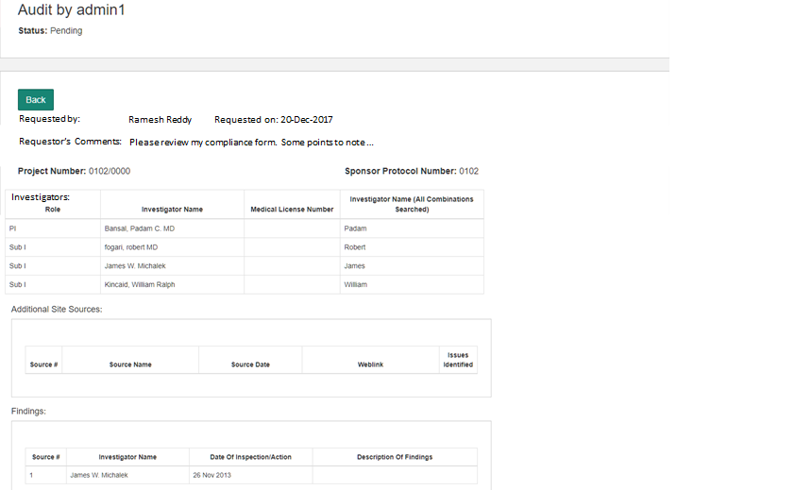
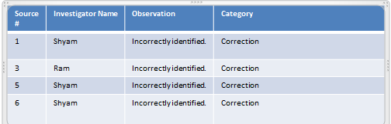
Requestor’s details, including comments.
Compliance Form, similar to the format of generated Compliance Form Word Document..
Summary of QC Verifier’s response..

Slide 20
Source # | Investigator Name | Observation | Category
1 | Shyam | Incorrectly identified. | Correction
3 | Ram | Incorrectly identified. | Correction
5 | Shyam | Incorrectly identified. | Correction
6 | Shyam | Incorrectly identified. | Correction

